Slide 1

A Multi-omics Ligand–Receptor Database for Neurodegenerative Diseases
Group A: Ding Chenyang, Tang Haocheng, Xu Shurui, Yu Chenzi
Presenter: Yu Chenzi
Date: 2025.12.16

Slide 2

01
Introduction
02
Research Question and Method
CONTENTS
03
Database Structure and Functions
04
Analysis Result and Conclusion
05
References and Contribution

Slide 3
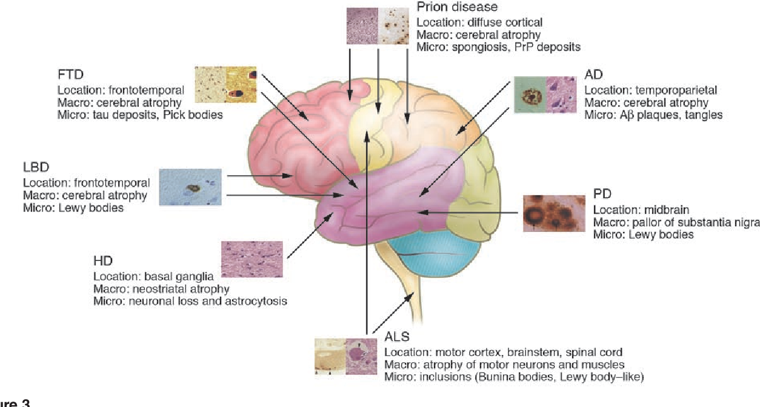
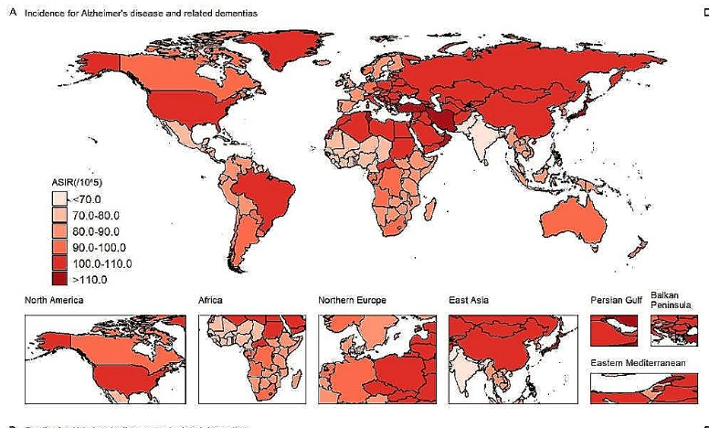
Introduction: Neurodegenerative Diseases
Definition: Progressive disorders marked by selective loss of neuronal structure and function, resulting in cognitive, motor, and behavioral decline
Typical Diseases:
Heavy global health burden
(Bertram and Tanzi, 2005)
Incidence for AD and other related dementias (Ji et al.,2024)
Notes:
这个图不体现increase，但是可以说heavy global burden of AD

Slide 4
Background and Research Focus
Current Research Background:
The shared mechanisms underlying various NDs remain poorly understood.
The role of secreted proteins and their receptors in ND, which plays a central role in intercellular communication, is not fully identified.
Our focus:
Establish a multi-omics and multi-disease database focusing on the secreted proteins and their receptors to investigate shared mechanisms across various NDs.
Neurodegenerative Secretome & Multiomics Database —— NeuroSecreDb
Notes:
Organisation of the programme and faculty
Biomedical sciences is an interdisciplinary field which interacts with the fields of biology, informatics, medicine and engineering.

Slide 5




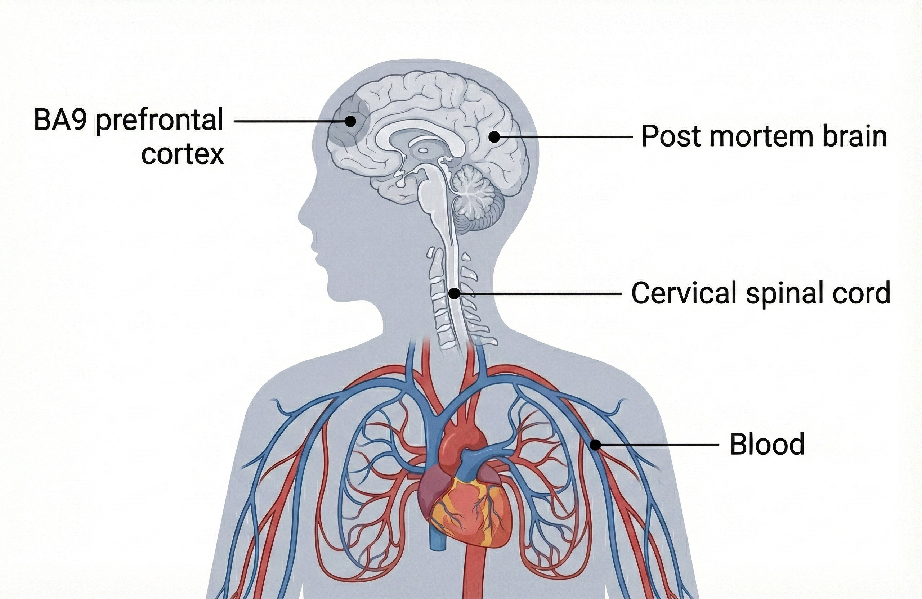
Neurodegenerative Secretome & Multiomics Database
HPA secreted pr.
UniProt secreted pr.
Data sources:
Gene Expression Omnibus (GEO)
Parkinson's progression markers initiative (PPMI)`
1704 Secreted protein reference:
HPA
UniProt
Number of NDs: 4
Number of tissue: 5
1054
1704
824
Data sources
Secreted protein reference Venn Diagram
Alzheimer’s Disease
Parkingson’s Disease
Huntington’s Disease
Amyotrophic Lateral Sclerosis
Processing pipeline
(Peripheral/ PBMC)
Cross-analysis
Overview of Data Screening Scope and Sample Distribution
Notes:
Here shows the data landscape
Secreted protein reference is double-checked by two databases
Based on this data, we create NeurosecreDB

Slide 6
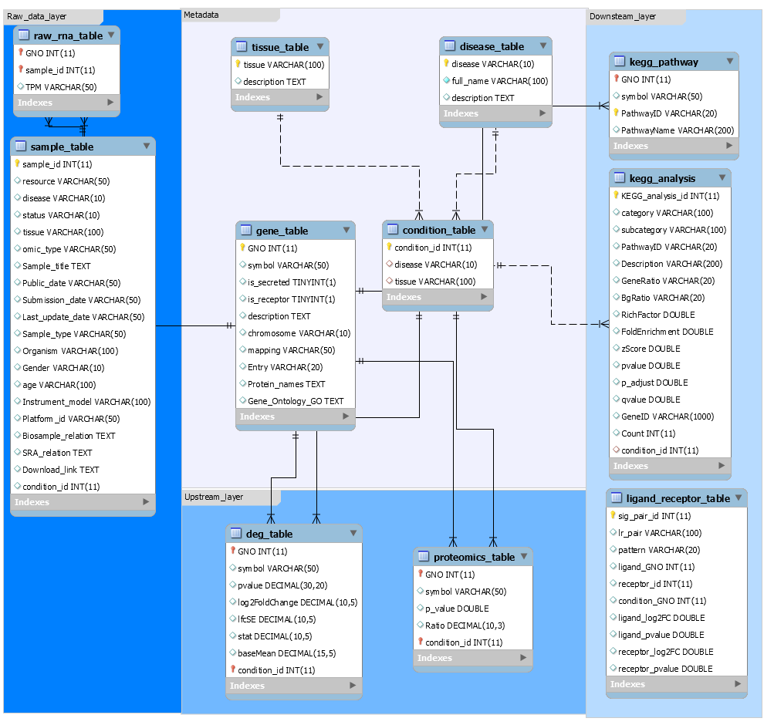
ER diagram
（full）
Metadata
Raw data
Functional enrichment
Differential analysis
Notes:
"This slide illustrates the basic structure of NeuroSecretDb, which is built on a relational database design to ensure systematic

Slide 7
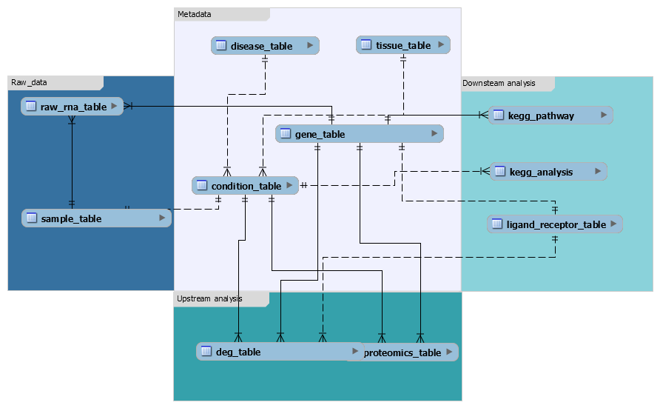
Basic Structure of NeuroSecreDb
ER diagram
Metadata
Data integrity
Scalable updates
Integrated queries
Raw data
Pathway enrichment
Differential analysis
Notes:
开头：
"Third, the derived analysis results.
deg_table stores pre-computed differential expression results, which feed directly into the user queries you saw earlier.
pathway_table and ligand_receptor_table contain curated knowledge for functional and interaction analyses.
Structuring results separately enables fast retrieval and complex, cross-table queries without reprocessing raw data."
结尾：
(Summarize the value of this structure) "In summary, this modular structure separates raw data, biological context, and analytical results. This is key for maintaining data integrity, enabling scalable updates, and supporting the complex, integrated queries

Slide 8
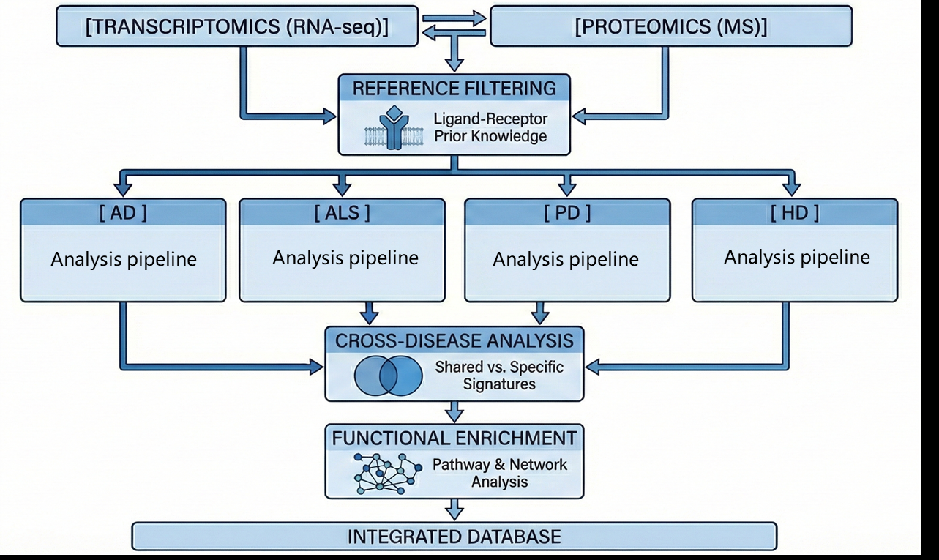
Function outline
Basic functions:
1. Cross-analysis for several disease
2. Multi-omic analysis for further validation
3. Ligand-receptor paired analysis
Research design for NeuroSecreDb

Slide 9
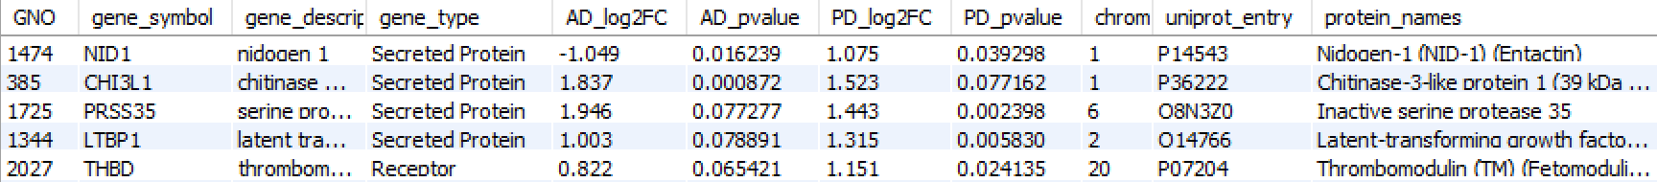
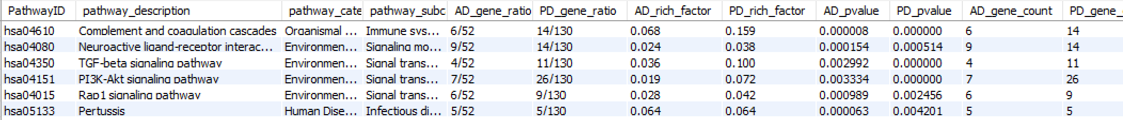
Analysis of Common DEG/ Pathway of Multiple Diseases
NeuroSecreDb integrates bulk RNA-seq datasets across several NDs and tissues
Query logic:
DEG_table
Gene_
description
Demo1.1: FindCommonDEGsTwoDiseases (‘AD’,’PD’,’Blood’)
Joined Table
Input
Filter
Gene infomation
Disease+Tissue
DEG infomation
Demo1.2: FindCommonPathwaysTwoDiseases (‘AD’,’PD’,’Blood’)
DEG_table
Gene_
description
Output View
Demo1.1
Notes:
"The database integrates bulk RNA-seq datasets from multiple neurodegenerative diseases and related tissues. Users can query by specifying disease type and tissue, and the system returns a differential expression gene table as the core output view.“
"Here is an example view. It includes gene symbols, descriptions, and importantly, gene type annotations—such as 'Secreted Protein' or 'Receptor'. The table highlights expression changes and statistical significance across diseases.

Slide 10
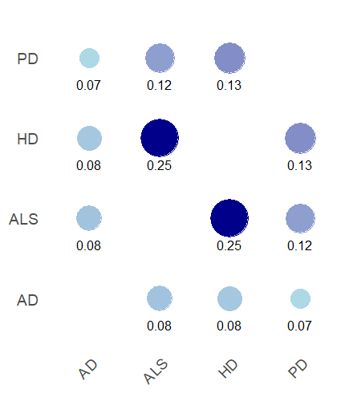
Shared DEGs across diseases
Shared DEGs across diseases in blood:
There are many DEGs present in multiple diseases.
HD and ALS are more similar in level of DEG, indicating shared pathogenesis.
Shared DEG ratio in blood

Slide 11
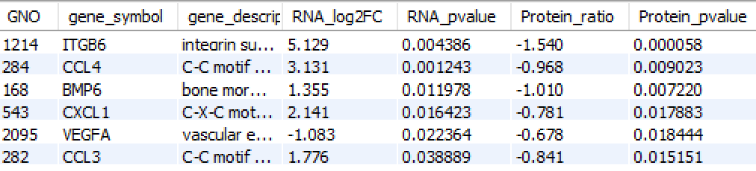
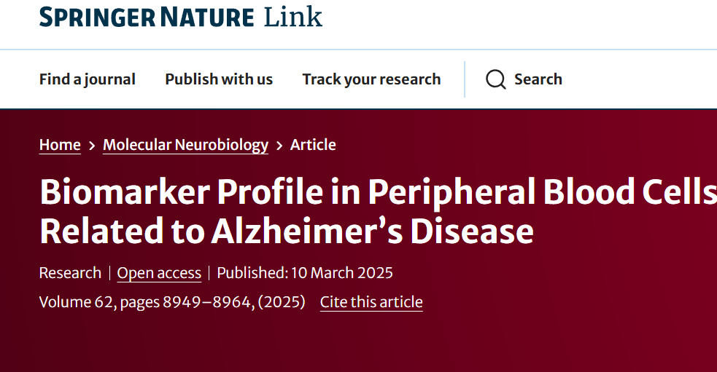
Multi-omics analysis
NeuroSecreDb integrates bulk RNA-seq and proteomic data for further validation
Demo 2: GetDiseaseMultiOmics (‘PD', 'Blood', 30);
Query logic:
DEG_table
Proteomics_table
Original Table
Input
Disease+Tissue
filter
DEG
DEP
Some have been proved: e.g. CXCL1
Contributions:
Enable validation across multiple omics
Improve the robustness and biological reliability.
DEG
DEP
Output View
Notes:
Return genes which are both significant in transcriptome and proteome
The rationality of our analysis

Slide 12
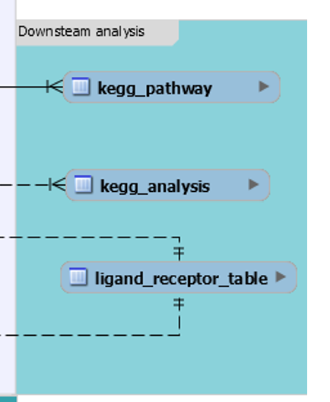
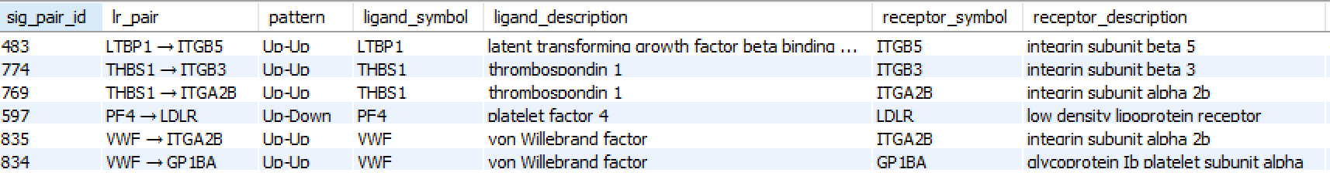
Ligand-Receptor analysis
The list of ligand-receptor pairs was derived from Ramilowski et al. (Nat.Conmmun. 2015).
DEG_table
ligand-receptor pairs
Demo3: CALL GetDiseaseLigandReceptor(‘AD’, 'Blood')

Slide 13
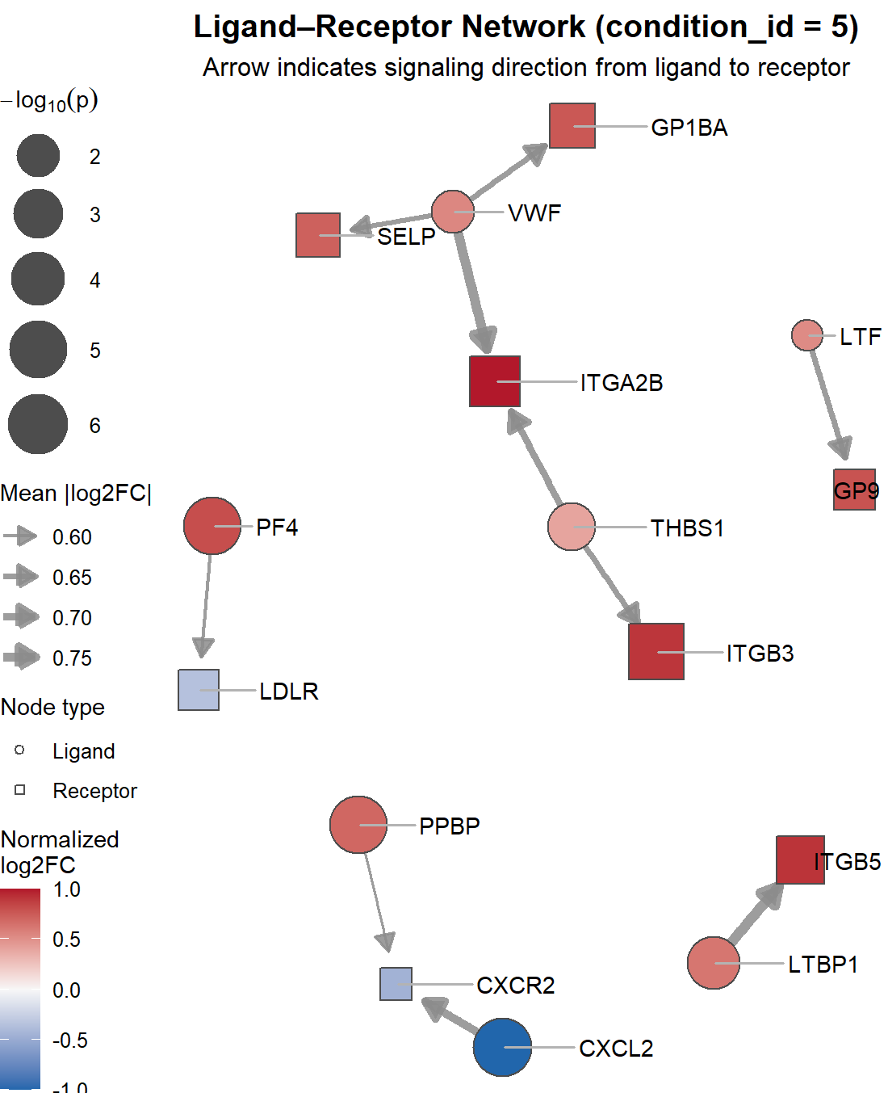
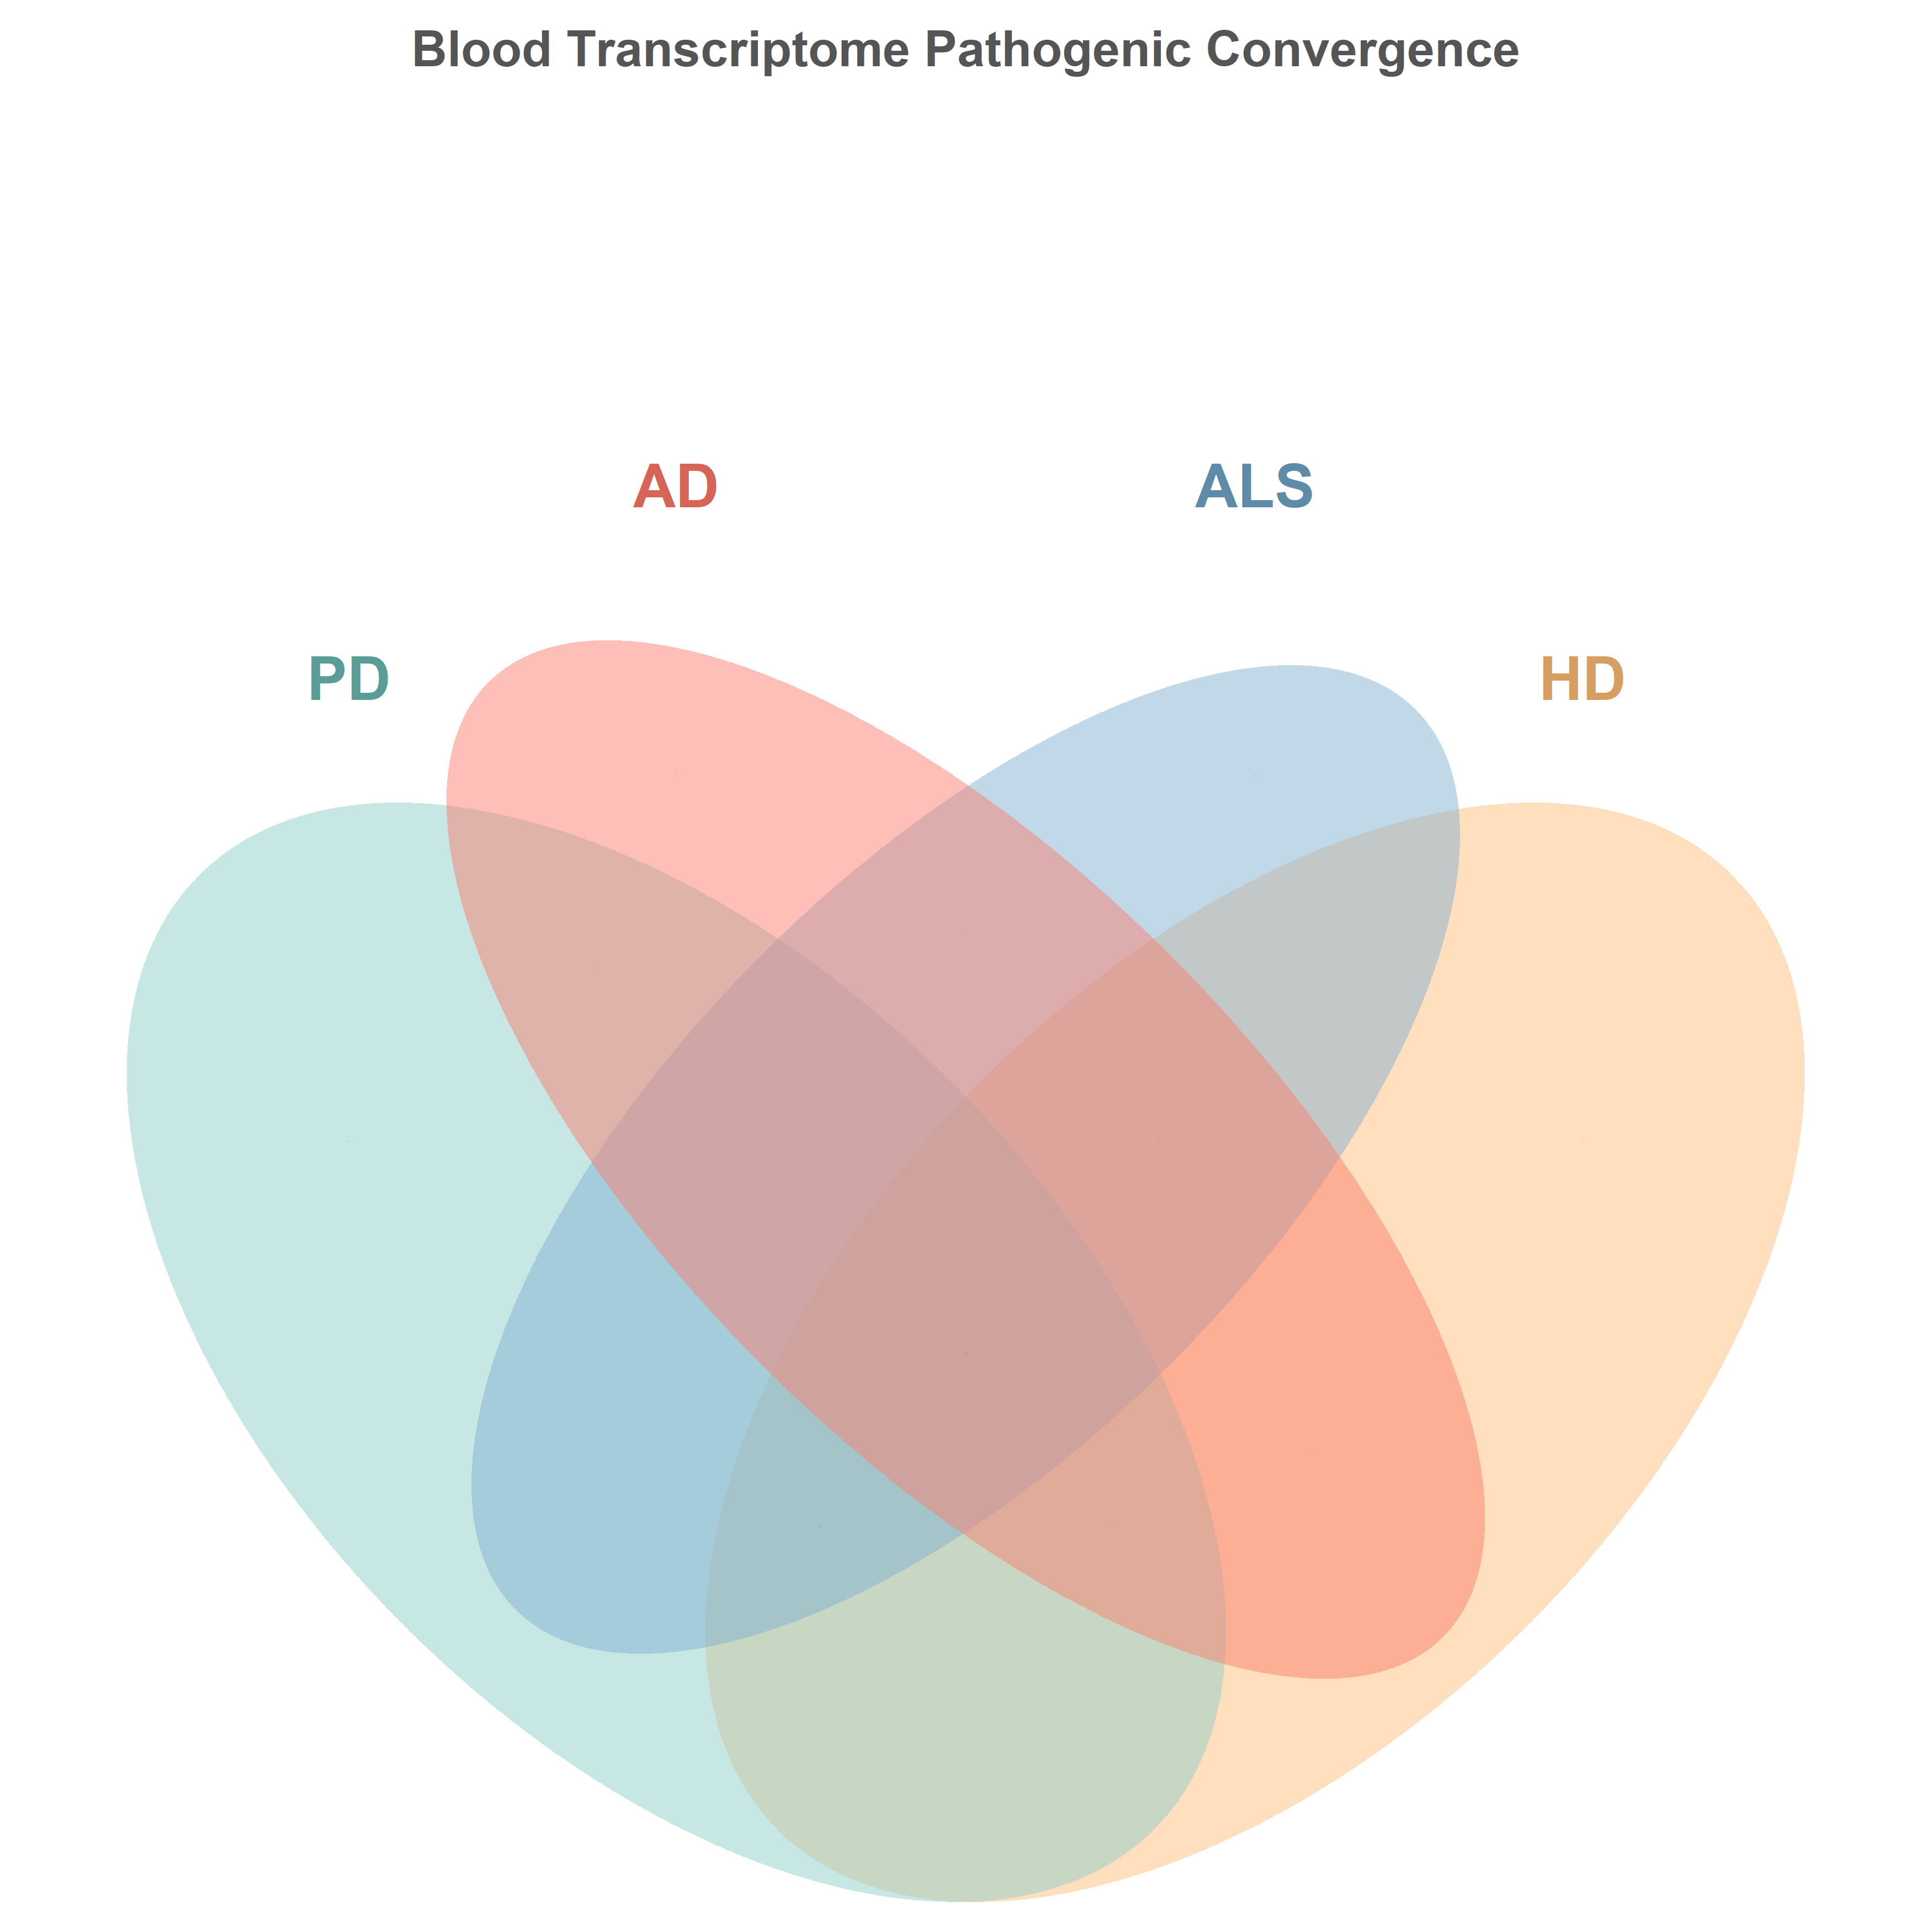
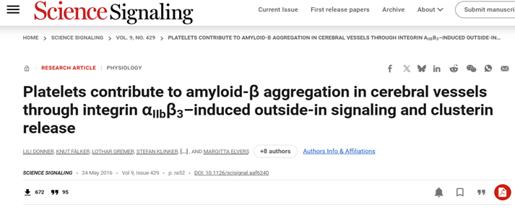
Our key findings
1. Shared DEG in blood
2. Shared pathways
3. Ligand-receptor analysis
e.g.: PI3K-Akt signaling pathway
AD blood sample
Identify 111 shared DEGs in blood:
Pathways of neurodegeneration
A1BG | PD,HD,ALS
ANGPT1 | PD,HD,ALS
PGLYRP1 | PD,HD,AD
ITGA2B | PD,HD,AD
LTBP1 | PD,AD,ALS
ITGA2B has been identified associated with AD (Donner, et., al,2016)
86
Shared Pathways in blood
ITGA2B-PI3K-Akt pathway axis may contribute to shared mechanism for NDs
Notes:
The pairs invoving ITGA2B, are also the components of PI3K-Akt pathway. Considering that this pathway is shared by 4 diseases and ITGA2B is also shared in 3 diesaes, We hypothesis that

Slide 14
Conclusion
NeuroSecreDb provides a systematic and extensible framework for exploring shared pathogenic pathways and potential biomarkers in NDs.
Cross-disease analysis, multi-omics validation and ligand-receptor analysis, not only identified common molecular mechanisms and emphasized the role of secreted proteins in ND.
We hypothesis that ITGA2B-PI3K-Akt pathway axis may contribute to shared mechanism for NDs

Slide 15
References
Agus, F. et al. (2019) ‘The caudate nucleus undergoes dramatic and unique transcriptional changes in human prodromal Huntington’s disease brain’, BMC medical genomics, 12(1), p. 137. Available at: https://doi.org/10.1186/s12920-019-0581-9.
Bertram, L. and Tanzi, R.E. (2005) ‘The genetic epidemiology of neurodegenerative disease’, The Journal of Clinical Investigation, 115(6), pp. 1449–1457. Available at: https://doi.org/10.1172/JCI24761.
Cavalier, A.N. et al. (2025) ‘Epigenetic dysregulation of transposable elements in cognitive impairment and Alzheimer’s disease’, GeroScience, 47(6), pp. 6731–6748. Available at: https://doi.org/10.1007/s11357-025-01765-9.
Donner, L. et al. (2016) ‘Platelets contribute to amyloid-β aggregation in cerebral vessels through integrin αIIbβ3-induced outside-in signaling and clusterin release’, Science Signaling, 9(429), p. ra52. Available at: https://doi.org/10.1126/scisignal.aaf6240.
Dumitriu, A. et al. (2016) ‘Integrative analyses of proteomics and RNA transcriptomics implicate mitochondrial processes, protein folding pathways and GWAS loci in Parkinson disease’, BMC medical genomics, 9, p. 5. Available at: https://doi.org/10.1186/s12920-016-0164-y.
Edgar, R., Domrachev, M., & Lash, A. E. (2002). Gene Expression Omnibus: NCBI gene expression and hybridization array data repository. Nucleic Acids Research, 30(1), 207-210. https://doi.org/10.1093/nar/30.1.207
Grima, N. et al. (2023) ‘RNA sequencing of peripheral blood in amyotrophic lateral sclerosis reveals distinct molecular subtypes: Considerations for biomarker discovery’, Neuropathology and Applied Neurobiology, 49(6), p. e12943. Available at: https://doi.org/10.1111/nan.12943.
Jiang, W. et al. (2025) ‘Association of RDoC dimensions with post mortem brain transcriptional profiles in Alzheimer’s disease’, Alzheimer’s & Dementia: Diagnosis, Assessment & Disease Monitoring, 17(2), p. e70103. Available at: https://doi.org/10.1002/dad2.70103.

Slide 16
References
Kanehisa, M., & Goto, S. (2000). KEGG: Kyoto Encyclopedia of Genes and Genomes. Nucleic Acids Research, 28(1), 27–30. https://doi.org/10.1093/nar/28.1.27
Labadorf, A. et al. (2015) ‘RNA Sequence Analysis of Human Huntington Disease Brain Reveals an Extensive Increase in Inflammatory and Developmental Gene Expression’, PloS One, 10(12), p. e0143563. Available at: https://doi.org/10.1371/journal.pone.0143563.
Labadorf, A., Choi, S.H. and Myers, R.H. (2017) ‘Evidence for a Pan-Neurodegenerative Disease Response in Huntington’s and Parkinson’s Disease Expression Profiles’, Frontiers in Molecular Neuroscience, 10, p. 430. Available at: https://doi.org/10.3389/fnmol.2017.00430.
Lomi, M. et al. (2025) ‘Biomarker Profile in Peripheral Blood Cells Related to Alzheimer’s Disease’, Molecular Neurobiology, 62(7), pp. 8949–8964. Available at: https://doi.org/10.1007/s12035-025-04767-y.
Marek, K., Chowdhury, S., Siderowf, A., Lasch, S., Coffey, C. S., Caspell-Garcia, C., ... & Parkinson’s Progression Markers Initiative. (2021). The Parkinson’s Progression Markers Initiative (PPMI) – establishing a PD biomarker cohort. Annals of Clinical and Translational Neurology, 8(8), 1600-1674. https://doi.org/10.1002/acn3.51407
Ramilowski, J.A. et al. (2015) ‘A draft network of ligand–receptor-mediated multicellular signalling in human’, Nature Communications, 6(1), p. 7866. Available at: https://doi.org/10.1038/ncomms8866.
Semenova, E.I. et al. (2022) ‘Transcriptome Profiling Reveals Differential Expression of Circadian Behavior Genes in Peripheral Blood of Monozygotic Twins Discordant for Parkinson’s Disease’, Cells, 11(16), p. 2599. Available at: https://doi.org/10.3390/cells11162599.
Zucca, S. et al. (2019) ‘RNA-Seq profiling in peripheral blood mononuclear cells of amyotrophic lateral sclerosis patients and controls’, Scientific Data, 6, p. 190006. Available at: https://doi.org/10.1038/sdata.2019.6.

Slide 17
Acknowledgement
The proteomics data was provided by the Parkinson's Progression Markers Initiative, a project sponsored by the Michael J. Fox Foundation for Parkinson's Research. The complete list of PPMI authors can be found at www.ppmi-info.org/about-ppmi/who-we-are/study-investigators.

Slide 18
Contribution
Yu Chenzi: PD bulk RNA& proteomic data collecting, cleaning and PD DEG data analysis, deg_table making; sample_table& condition_table& proteomic_table making; common pathway analysis; keys setting in MySQL; ERD making, ppt making; presenting.
Ding Chenyang: ALS bulk RNA& proteomic data collecting, cleaning and ALS DEG data analysis, deg_table making; tables in downstream analysis making; ligand-receptor analysis; importing tables into MySQL, ppt making.
Xu Shurui: HD bulk RNA& proteomic data collecting, cleaning and HD DEG data analysis, deg_table making; raw_rna_table making; workflow visualization; shared pathway visiualization; tissues figure making; ppt making.
Tang Haocheng: AD bulk RNA& proteomic data collecting, cleaning and AD DEG data analysis, deg_table making; gene_table& disease_table& tissue_table making; shared pathway analysis and proof finding; ppt making.
Notes:
Finally, I’d like to thank my team for everyone’s contribution.

Slide 19

THANKS
DST2 Group A
2025/12/16

Slide 20
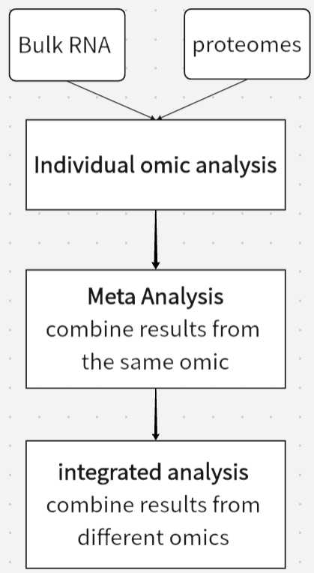

Contribution
Neurodegenerative Secretome & Multiomics Database
NeuroSecreDb
Alzheimer’s Disease
Parkingson’s Disease
Huntington’s Disease
Amyotrophic Lateral Sclerosis
Processing pipeline
Cross-analysis
Constructing a specialized database to integrate diverse datasets
Cross-analysis of multiple diseases reveals potential common pathways
Multi-omics analysis for validation

Slide 21
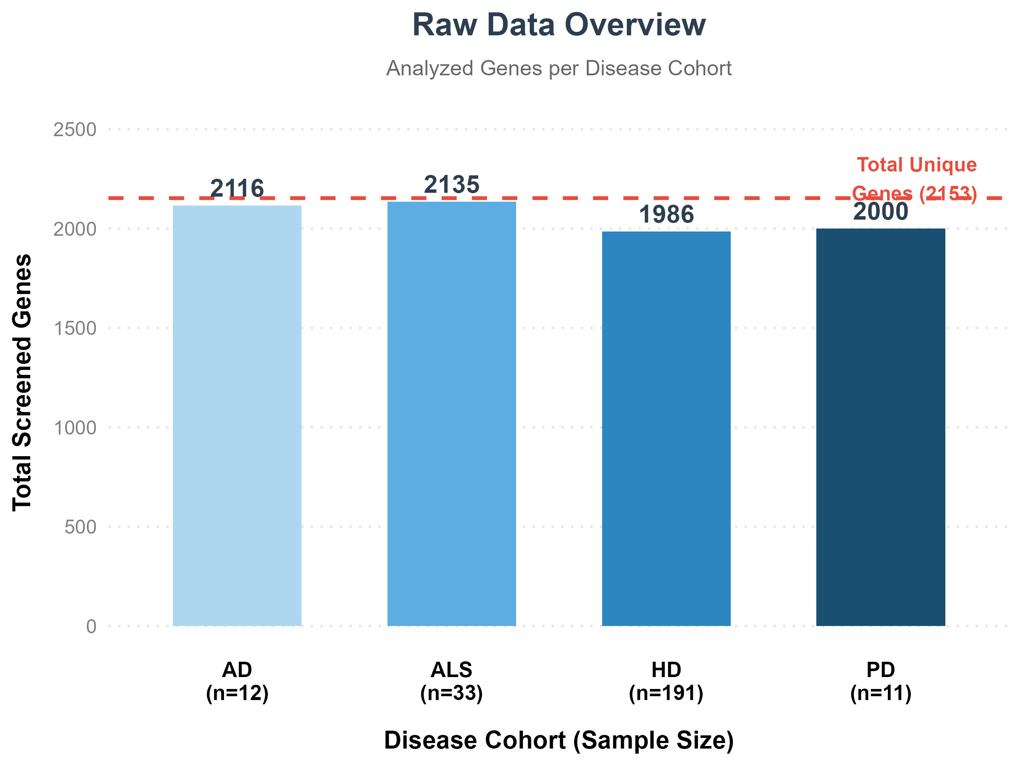
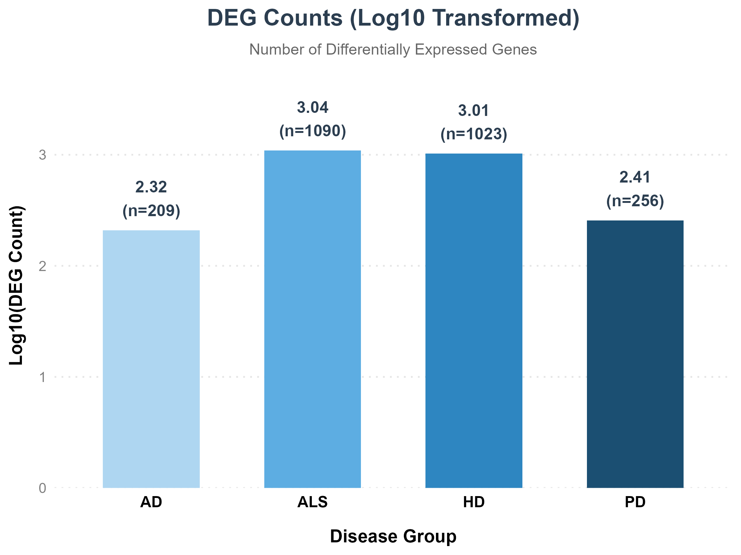
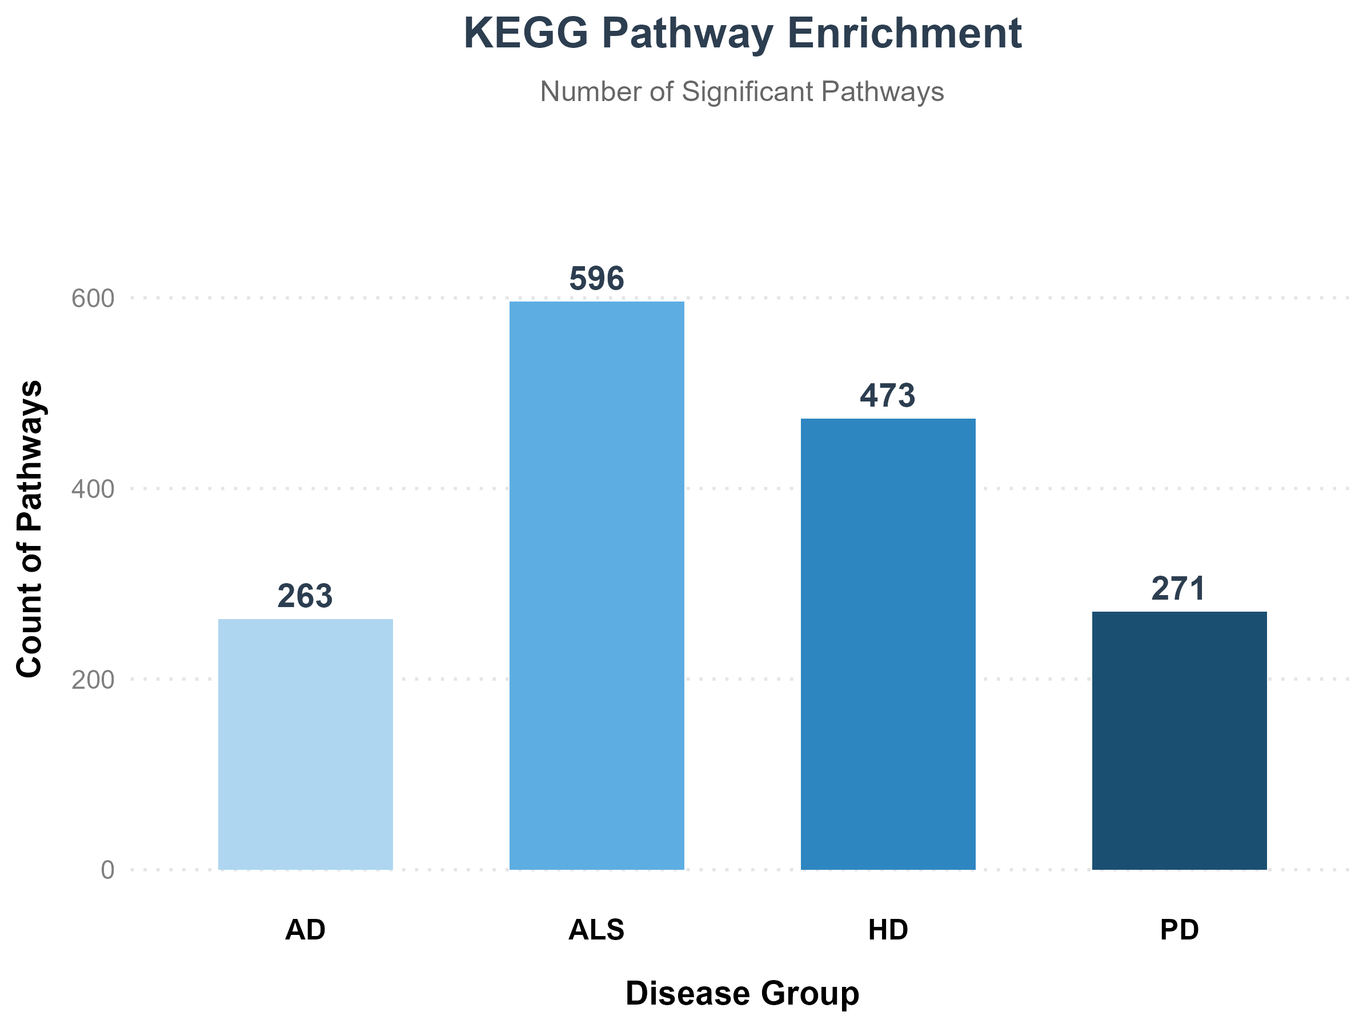
Data Collection Overview
Total unique genes (2153)
Screened genes are genes encoding secreted proteins and their receptor
DEG means Differentially Expressed Gene
Significantly enriched biological pathways
Notes:
High collection rate

